Slide 1
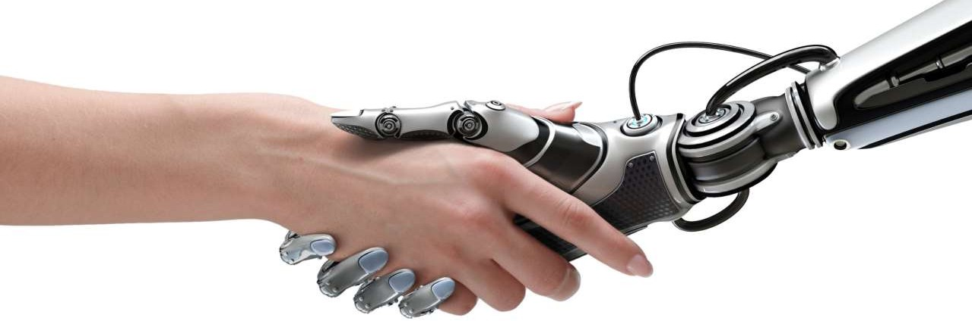
s
ARTIFICIAL INTELLIGENCE (A.I.)

Slide 2
Electrical Controller
P
PI
PD
PID

Slide 3
MOVIES
1.ROBO
2. 7th Scene
3. FUZZY LOGIC Machines

Slide 4
Intelligent Control System COURSE OUTCOMES
COURSE OUTCOMES: At the end of the course, the students will be able to:
CO1: Comprehend the concepts of biological neurons and artificial neurons. (Understand-L2)
CO2: Analyze the feed-forward and feedback neural networks and their learning algorithms.(Apply-L3)
CO3: Comprehend the neural network training and design concepts (Apply-L3)
CO4: Comprehend the concept of fuzziness involved in various systems, fuzzy set theory, member ship functions and their Implementation methods and fuzzy logic (Apply-L3)
CO5: Apply fuzzy logic to real world problems. (Apply-L3)

Slide 5
ICS SYLLABUS
UNIT-I: ARCHITECTURE OF NEURAL NETWORKS Architectures: motivation for the development of natural networks-artificial neural networksbiological neural networks- Potential Applications of ANN -typical Architecture-setting weightscommon activations functions, Historical Developments, Mcculloch-Pitts neuron- Architecture, algorithm, applications-single layer net for pattern classification- Biases and thresholds, linear separability - Learning Strategy (Supervised, Unsupervised, Reinforcement), Learning Rules, Basic learning rules (Hebb’s rule, perceptron rule, Delta Rule etc.) Basic Problems
UNIT–II: BASIC NEURAL NETWORK TECHNIQUES Supervised Learning Neural Network : Perceptron Model, Adaline Model, M-adaline Model, Back propagation neural net standard back propagation-architecture algorithm- derivation of learning rules number of hidden layers Unsupervised Learning Neural Network : Radial Basis Function networks: Topology, learning algorithm; Kohenen’s self-organising network: Topology, learning algorithm- and Discrete Hopfield networks.

Slide 6
ICS SYLLABUS
UNIT–III: NEURAL MEMORY UNIT & RECURRENT NEURAL NETWORK Neural Memory unit: associative and other neural networks- hetro associative memory neural net, auto associative net- Bidirectional associative memory-applications-Hopfield nets-Boltzman machine Recurrent neural networks: Basic concepts, Architecture and training algorithms, Applications; Hopfield network: Topology, learning algorithm, Long Short Term Memory, Gated Recurrent Units, Bidirectional LSTMs, Bidirectional RNNs
UNIT–IV: INTRODUCTION TO FUZZY LOGIC SYSTEM Classical and fuzzy sets: Introduction, Operations and Properties, Fuzzy Relations: Cardinality, Operations and Properties, Equivalence and tolerance relation, Value assignment: cosine amplitude and max-min method; Fuzzification: Membership value assignment- Inference, rank ordering, angular fuzzy sets. Defuzzification methods, Fuzzy arithmetic; composition and inference
UNIT-V: APPLICATIONS OF FUZZY LOGIC AND FUZZY SYSTEMS: Basic structure and operation of fuzzy logic control systems; Design methodology; Applications of fuzzy controllers, control of phase controlled dc motor drive by using fuzzy logic controllers , Simple applications of fuzzy knowledge based controllers like washing machines, home heating system, and train break control.

Slide 7
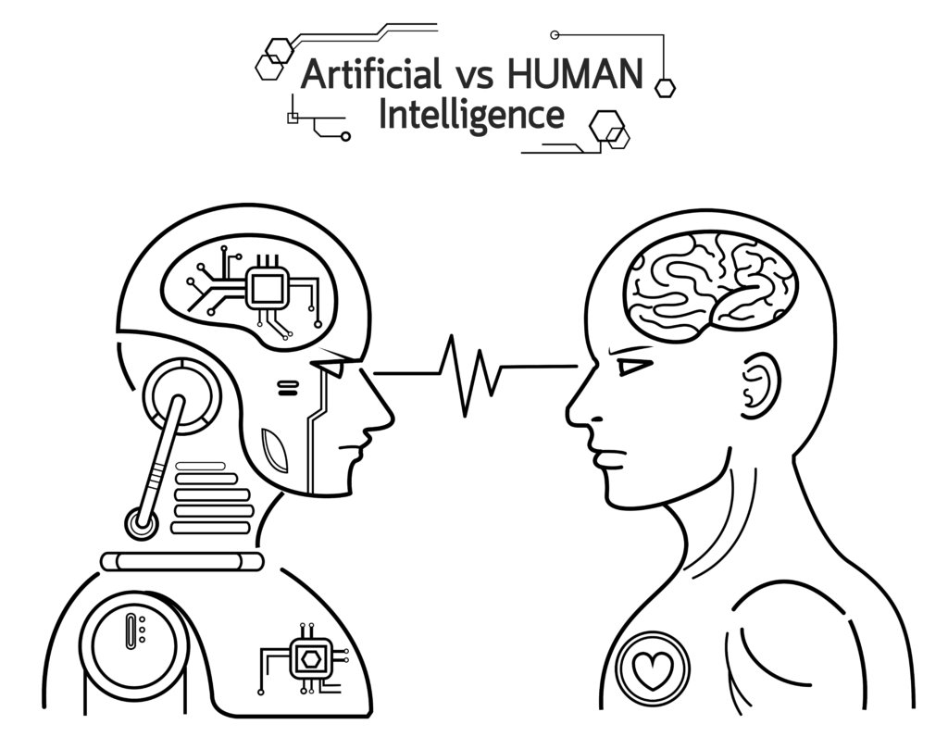

Slide 8
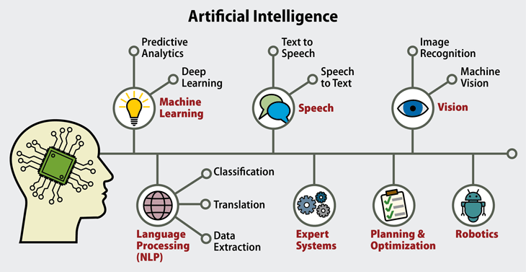

Slide 9
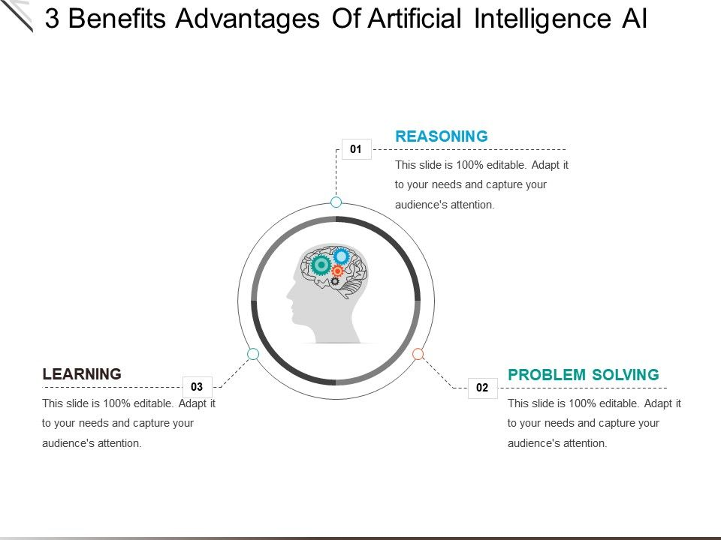

Slide 10
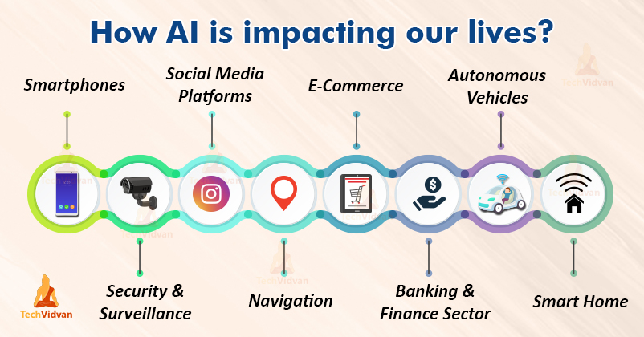

Slide 11



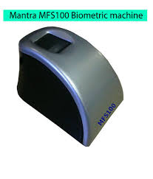
India Population 135 Croce's

Slide 12

What is intelligence?
Intelligence can be described as the ability to acquire or perceive the information and retain it as knowledge and finally apply it to find a solution in a context.
It includes
Capacity for logic
Understanding
Self-awareness
Communication
Learning
Emotional knowledge
Memory
Planning
Creativity
Problem Solving

Slide 13

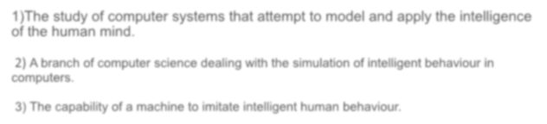


The study of computer systems that attempt to model and apply the intelligence of the human mind.
A branch of computer science dealing with the simulation of intelligent behavior in computers.
The capability of a machine to imitate intelligent human behaviour.

Slide 14
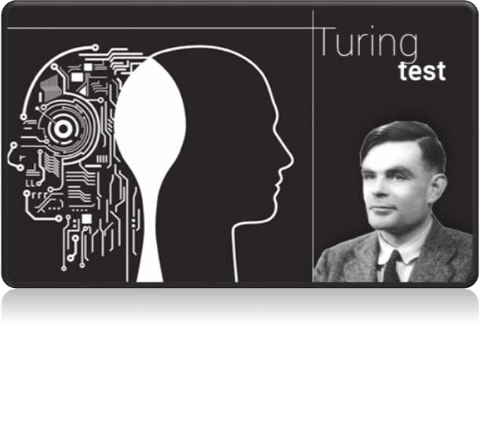

Early History
In 1950 English mathematician Alan Turing wrote a landmark paper titled “Computing
Machinery and Intelligence” that asked the question: “Can
machines think?”
Further work came out of a 1956 workshop at Dartmouth sponsored by John McCarthy. In the proposal for that workshop, he coined the phrase a “study of Artificial Intelligence”

Slide 15


AI have taken many shapes and forms over recent years
Mobile Phones ( Siri/ alexa/Cortana)
Video Games Characters
GPS/ Voice Recognition
Search Items
Image recognition/Pattern recognition
Robotics
Google has been a major play on AI transcendence and Deep Learning.
Deep learning is a machine learning based on algorithms.

Slide 16

CHALLENGES
Computing Power
Tolerance Power
Intuitive Thinking
Judging Power

Slide 17


FUTURE OF AI
Automated Transportation.
Improved Medical Care &Treatment.
Cyborg Technology
Taking over dangerous jobs
Solving climate change
Robot as friends
Improved elder care, etc.
60 to 70% works can be done only
AI in year 2025

Slide 18


PROS & CONS
Precision and Accuracy ▪ Cost incurred in the maintenance
Space exploration ▪ Not able to act any different
Used for mining process ▪ Lack the human touch
Can do laborious tasks ▪ Lack a creative mind
Fraud detection, manage records. ▪ Lack common sense
Lacking the emotional side ▪ Unemployment
Can do repetitive and time-consuming tasks ▪ Abilities of humans may iminish
Robotic pets, Robotic radiosurgery. ▪ Robots superseding humans
Function without stopping, Risk Reducing. ▪ Humans may became dependent on machines.
Diagnosis and Treatment ▪ Wrong hands causes destruction

Slide 19
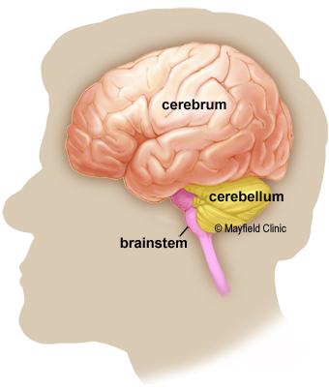
Human Brain
Cerebrum: is the largest part of the brain and is composed of right and left hemispheres. It performs higher functions like interpreting touch, vision and hearing, as well as speech, reasoning, emotions, learning, and fine control of movement.
Cerebellum: is located under the cerebrum. Its function is to coordinate muscle movements, maintain posture, and balance.
Brainstem: acts as a relay center connecting the cerebrum and cerebellum to the spinal cord. It performs many automatic functions such as breathing, heart rate, body temperature, wake and sleep cycles, digestion, sneezing, coughing, vomiting, and swallowing.

Slide 20
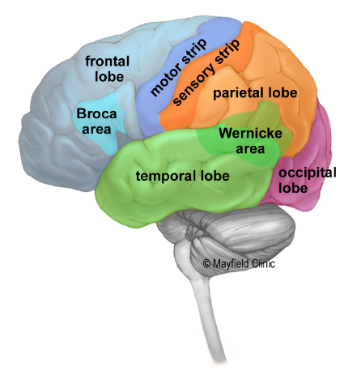
Human Brain
Frontal lobe (blue):
Personality, behavior, emotions
Judgement, planning, problem solving
Speech: speaking and writing (Broca’s area)
Body movement (motor strip)
Intelligence, concentration, self awareness
Parietal lobe (orange)
Interprets language, words
Sense of touch, pain, temperature (Sensory strip)
Interprets vision, hearing, sensory and memory
Spatial and visual perception
Occipital lobe (purple)
Interprets vision (color, light, movement)
Temporal lobe (green)
Understanding language (Wernicke’s area)
Memory
Hearing
Sequencing and organization

Slide 21
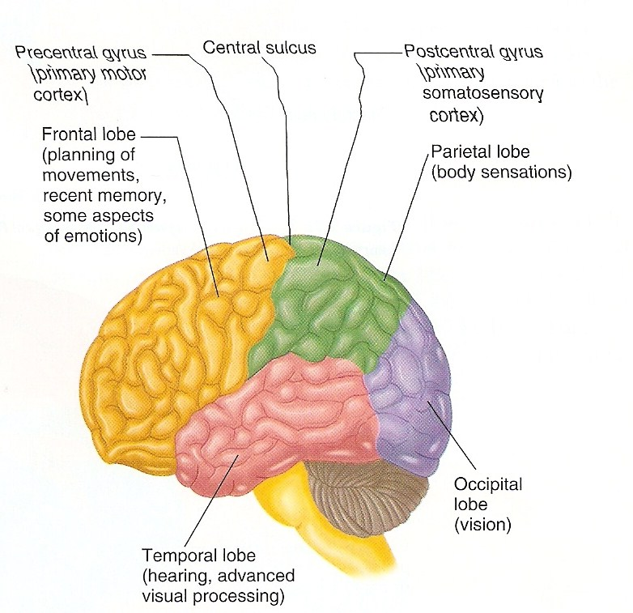
Human Brain consists of neurons10¹⁰ and interconnection of 10⁴ of each neuron Brain network is massively Parallel

Slide 22
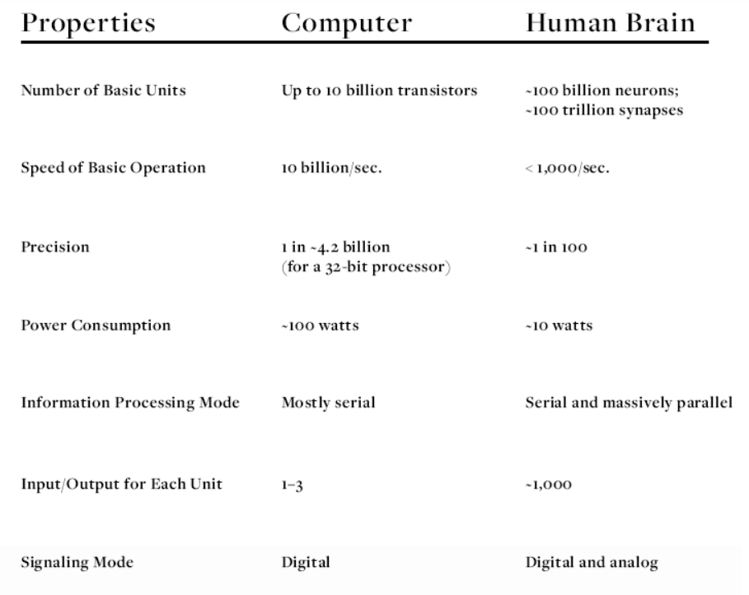

Slide 23
NNs vs Computers
Digital Computers
Deductive Reasoning. We apply known rules to input data to produce output.
Computation is centralized, synchronous, and serial.
Memory is packetted, literally stored, and location addressable.
Not fault tolerant. One transistor goes and it no longer works.
Exact.
Static connectivity.
Applicable if well defined rules with precise input data.
Neural Networks
Inductive Reasoning. Given input and output data (training examples), we construct the rules.
Computation is collective, asynchronous, and parallel.
Memory is distributed, internalized, short term and content addressable.
Fault tolerant, redundancy, and sharing of responsibilities.
Inexact.
Dynamic connectivity.
Applicable if rules are unknown or complicated, or if data are noisy or partial.

Slide 24
Biological Neuron Network

Slide 25
Biological Neuron Network
Neurons, membranes, channels
Structure of Neurons: dendrites, cell body and axon
Input: Synapses on dendrites and cell body (soma)
Output: Axon, myelin for fast signal propagation
Function of Neurons:
Internal voltage controlled by Na/K/Cl… channels
Channels gated by chemicals (neurotransmitters) and membrane voltage
Inputs at synapses release neurotransmitter, causing increase or decrease in membrane voltages (via currents in channels)
Large positive change in voltage → membrane voltage exceeds threshold → action potential or spike generated.

Slide 26
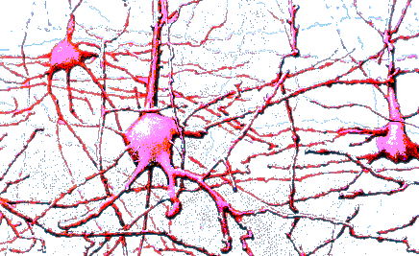
Biological Neuron
Animals are able to react adaptively to changes in their external and internal environment, and they use their nervous system to perform these behaviours.
An appropriate model/simulation of the nervous system should be able to produce similar responses and behaviours in artificial systems.

Slide 27
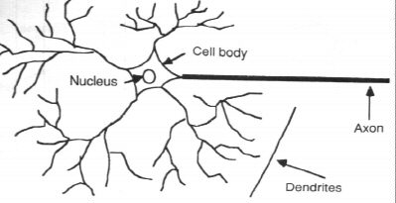
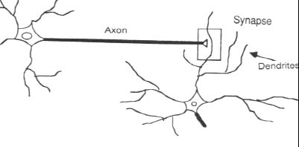
Biological Neuron
The information transmission happens at the synapses. Distance between 2 dentrites in between 2 neurons is 2nm
Average Weight of Human Brain 1.5kg
Length of each neuron is approximately 0.01mm to 1mm
Average Weight of each neuron is approximately 1.5*10^-19 gms

Slide 28
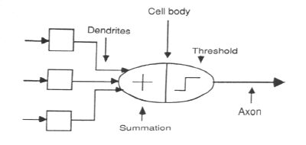
Neuron Model
Abstract neuron model:

Slide 29
WHY ARTIFICIAL NEURAL NETWORKS? The long course of evolution has given the human brain many desirable characteristics not present in von Neumann or modern parallel computers. These massively parallel systems with large numbers of interconnected simple processors may solve a variety of challenging computational problems. These include .Massive parallelism .Distributed representation and computation .Learning ability .Generalization ability .Adaptively .Inherent contextual information processing .Fault tolerance and .Low energy consumption.

Slide 30
Artificial Neural Network
ANNs are also named as “artificial neural systems,” or “parallel distributed processing systems,” or “connectionist systems.”
ANN acquires a large collection of units that are interconnected in some pattern to allow communication between the units.
These units, also referred to as nodes or neurons, are simple processors which operate in parallel.
Every neuron is connected with other neuron through a connection link. Each connection link is associated with a weight that has information about the input signal.
This is the most useful information for neurons to solve a particular problem because the weight usually excites or inhibits the signal that is being communicated.
Each neuron has an internal state, which is called an activation signal. Output signals, which are produced after combining the input signals and activation rule, may be sent to other units.

Slide 31

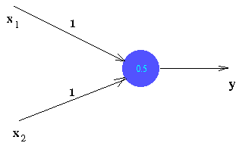
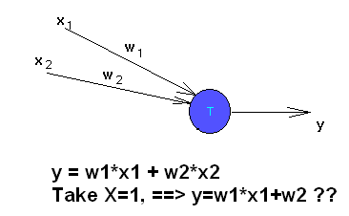
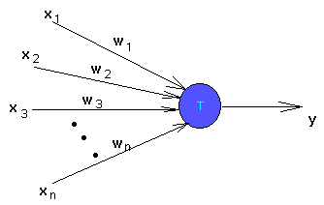
Artificial neurons Neuron

Slide 32
Artificial Neural Networks
x₁
X₁
w₁
y_{in}
A.F = f()
Output(Y)
Y
x₂
w₂
X₂

Slide 33
Artificial neural networks
Output
Inputs
An artificial neural network is composed of many artificial neurons that are linked together according to a specific network architecture. The objective of the neural network is to transform the inputs into meaningful outputs.

Slide 34
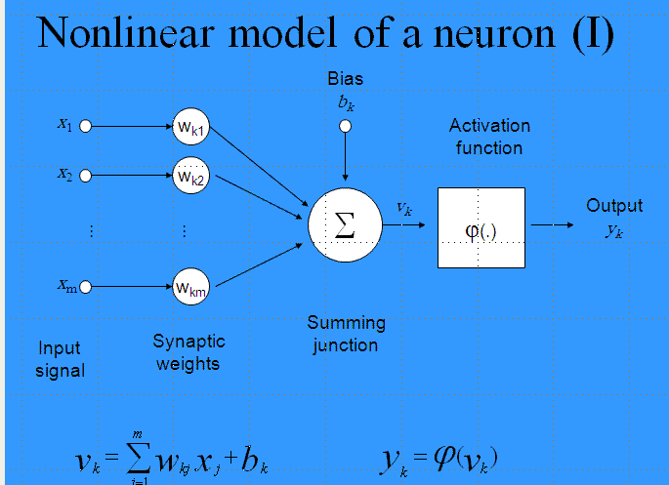
Model of Artificial neuron
An appropriate model/simulation of the nervous system should be able to produce similar responses and behaviours in artificial systems.
The nervous system is build by relatively simple units, the neurons, so copying their behaviour and functionality should be the solution.

Slide 35
Artificial neurons
Nonlinear generalization of neuron:
y is the neuron’s output, x is the vector of inputs, and w is the vector of synaptic weights.
Examples:
sigmoid neuron
Gaussian neuron

Slide 36
Weights
Each neuron is connected to every other neuron by means of directed links
Links are associated with weights
Weights contain information about the input signal and is represented as a matrix
Weight matrix also called connection matrix

Slide 37
Weight matrix
W=
=

Slide 38
Weights contd…
w_{ij –}is the weight from processing element ”i” (source node) to processing element “j” (destination node)
1
X₁
b_{j}
w_{1j}
X_{i}
Y_{j}
w_{ij}
X_{n}
w_{nj}

Slide 39
Activation Functions
Used to calculate the output response of a neuron.
Sum of the weighted input signal is applied with an activation to obtain the response.
Activation functions can be linear or non linear
Bipolar binary and unipolar binary are called as hard limiting activation functions used in discrete neuron model
Unipolar continuous and bipolar continuous are called soft limiting activation functions are called sigmoidal characteristics.
Already dealt
Identity function
Single/binary step function
Discrete/continuous sigmoidal function.

Slide 40
Bias
Bias is like another weight. Its included by adding a component x₀=1 to the input vector X.
X=(1,X₁,X₂…X_{i},…X_{n})
Bias is of two types
Positive bias: increase the net input
Negative bias: decrease the net input

Slide 41
Why Bias is required?
The relationship between input and output given by the equation of straight line y=mx+c
C(bias)
Input
X
Y
y=mx+C

Slide 42
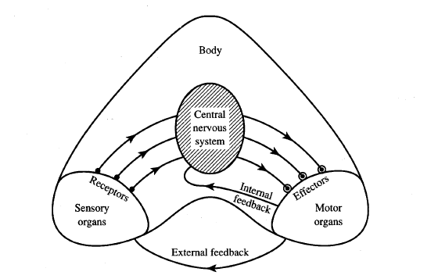
Information flow in nervous system

Slide 43
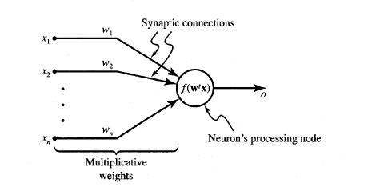
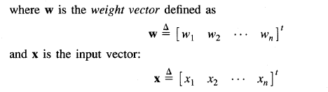
General symbol of neuron consisting of processing node and synaptic connections

Slide 44
Threshold
Set value based upon which the final output of the network may be calculated
Used in activation function
The activation function using threshold can be defined as
Learning rate
Denoted by α.
Used to control the amount of weight adjustment at each step of training
Learning rate ranging from 0 to 1 determines the rate of learning in each time step

Slide 45
Model of Artificial neuron
Activation function: An activation function f performs a mathematical operation on the signal output. The most common activation functions are:
- Linear Function,
- Threshold Function,
- Sigmoidal (S shaped) function,
The activation functions are chosen depending upon the type of problem to be solved by the network.

Slide 46
Neuron Modeling for ANN
Is referred to activation function. Domain is set of activation values net.
Scalar product of weight and input vector
Neuron as a processing node performs the operation of summation of its weighted input.

Slide 47
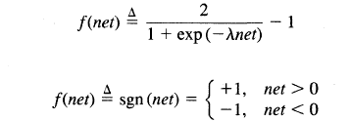
Activation functions
Bipolar continuous
Bipolar binary functions

Slide 48
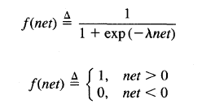
Activation functions
Unipolar continuous
Unipolar Binary

Slide 49
Model of Artificial neuron
Activation Functions f – Types:-
Threshold Function
A threshold (hard-limiter) activation function is either a binary type or a bipolar type.
Output of a binary threshold function produces :
1 if the weighted sum of the inputs is +ve,
0 if the weighted sum of the inputs is –ve.
Output of a bipolar threshold function produces :
1 if the weighted sum of the inputs is +ve,
-1 if the weighted sum of the inputs is –ve.

Slide 50
Model of Artificial neuron
Activation Functions f – Types:-
Sigmoidal Function (S-shape function):-
The nonlinear curved S-shape function is called the sigmoid function. This is most common type of activation used to construct the neural networks. It is mathematically well behaved, differentiable and strictly increasing function.
This is explained as
≈ 0 for large -ve input values,
1 for large +ve values, with a smooth transition between the two.
α is slope parameter also called shape parameter symbol the λ is also used to represented this parameter.

Slide 51
ANN:Classification
An artificial Neural Network is defined as a data processing system consisting of a large number of interconnected processing elements or artificial neurons.
There are three fundamentally different classes of neural networks. Those are.
1. Single layer feedforward Networks.
2. Multilayer feedforward Networks.
3. Recurrent Networks.
Here we have to discuss the single layer feed forward network.

Slide 52
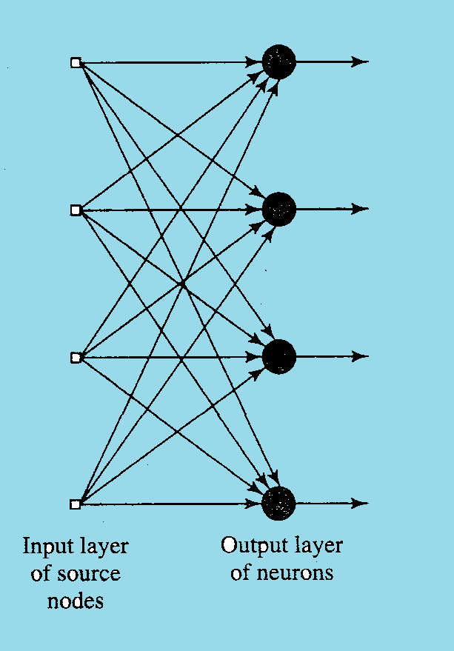
Single-layer feed forward network
- Input layer of source nodes that projects directly
onto an output layer of neurons.
- “Single-layer” referring to the output layer of computation nodes (neuron).

Slide 53
Single-layer Feed forward network
Ii1
Oi1
1
W11
Yo1
Ii2
Io1
Oi2
W21
1
2
Io2
Yo2
Ii3
Oi3
W31
2
3
Iom
Yom
Iin
Wn1
3
Oin
4
The above figure is a single layer feed forward neural network. It consists an input layer to receive the inputs and an output layer to output the vectors.
The input layer consists of ‘n’ neurons, and the output layer contains ‘m’ neurons .
The weight of synapse connecting ith input neuron the jth output neuron is Wij.

Slide 54
Single-layer Feed forward network
Here the inputs of the input layer and the outputs of the output layer is given as
So
Hence, the input to the output layer can be given as
Because
The block diagram of a single layer feed forward network.
F(I,W)
I
O

Slide 55
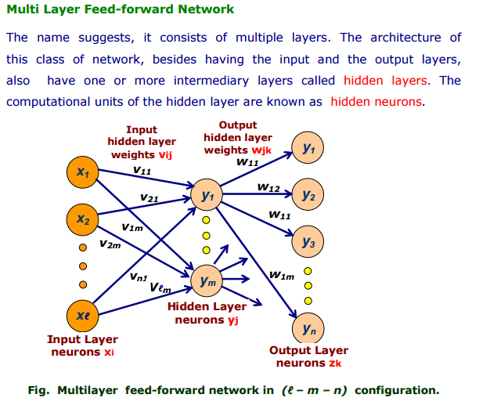

Slide 56
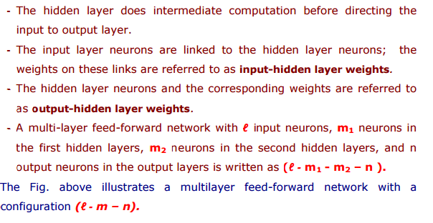

Slide 57
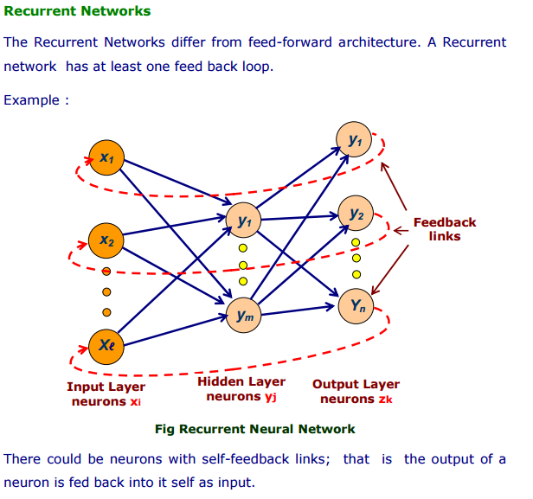

Slide 58
Historical Development of ANN
1943 − McCulloch and Pitts: Start of the modern era of NN
McCulloch and Pitts outlined the first formal model of an elementary computing neuron. A network consists of sufficient number of neurons and properly set synaptic connections can compute any logic function. A simple logic function is performed by a neuron in this case based upon the weights set in the McCulloch and Pitts neuron.
1949 − Donald Hebb’s book, The Organization of Behavior
Hebb proposed a first learning scheme for updating neuron’s connections that is referred as the Hebbian learning rule. It is based on synaptic modification i.e. Hebb proposed that the connectivity of the brain is continually changing as an organism learns different functional tasks.
If two neurons on either side of a synapse (connection) are activated simultaneously (i.e. synchronously), then the strength of that synapse is selectively increased.

Slide 59
Historical Development of ANN
1954- Minsky: The first neurocomputers were built and tested. They adapted connections automatically.
1958-Frank Rosenblatt introduces Perceptron
It was a trainable machine capable of learning to classify certain patterns by modifying connections to the threshold elements i.e. by adjusting the weights on the connection paths.
1960-Bernard Widrow and Marcian Hoff introduces ADALINE
ADALINE means ADAptive LINEar Neuron. Widrow-Hoff learning rule minimizes the summed square error during training involving pattern classification. Its extension is MADALINE (for Many ADALINE) with applications include pattern recognition, weather forecasting, and adaptive controls.
1969 − Multilayer perceptron (MLP) was invented by Minsky and Papert.

Slide 60
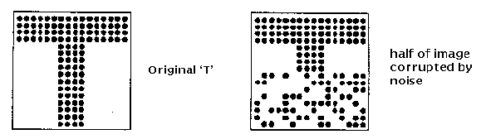
Historical Development of ANN
1980- Kunihiko Fukushima and Miyaka- Neocognitrons is a model for visual pattern recognition and is concerned with biological plausibility. The network emulates the retinal images and processes them using 2-D layers of neurons.
1982-Kohonen – Self Organizing Map(SOM) networks are used to cluster input patterns into groups of similar patterns. They're called "maps" because they assume a topological structure among their cluster units; effectively mapping weights to input data.
1982-John Hopfield networks introduces a recurrent neural network architecture for associative memories.

Slide 61
Historical Development of ANN
1985- Parker, Rumelhart, Hinton and Williams- Backpropagation networks is most popular learning algorithm for the training of multilayer feedforward networks. This method propagates the error information at the output units back to the hidden units.
1985 − Boltzmann machine was developed by Ackley, Hinton, and Sejnowski.
1987- Carpenter and Grossberg invented Adaptive Resonance Theory (ART). ART1 forms the design for the binary inputs and ART2 came to design for continuous valued inputs.
1988-Grossberg-Counter Propagation networks uses the Grossberg learning also called as outstar learning which is concerned with supervised learning.
1988 − Bart Kosko developed Binary Associative Memory (BAM) and also gave the concept of Fuzzy Logic in ANN.
1988 – Broomhead and Lowe developed Radial Basis Functions (RBF). This is also a multilayer network.

Slide 62
Historical Development of NN
1964 − Taylor constructed a winner-take-all circuit with inhibitions among output units.
1969 − Multilayer perceptron (MLP) was invented by Minsky and Papert.
1971 − Kohonen developed Associative memories.
1976 − Stephen Grossberg and Gail Carpenter developed Adaptive resonance theory.
1982 − The major development was Hopfield’s Energy approach.
1985 − Boltzmann machine was developed by Ackley, Hinton, and Sejnowski.
1986 − Rumelhart, Hinton, and Williams introduced Generalised Delta Rule.
1988 − Kosko developed Binary Associative Memory (BAM) and also gave the concept of Fuzzy Logic in ANN.

Slide 63
Learning in ANN
Learning methods in neural networks can be broadly classified in three basic types.
- Supervised Learning
- Unsupervised Learning
- Reinforcement Learning
Supervised Learning:-
In supervised learning, both the inputs and the outputs are provided. The network then processes the inputs and compares its resulting outputs against the desired outputs
Errors are then calculated, causing the system to adjust the weights which control the network.
Here a teacher is assume to be present during the learning process.

Slide 64
Supervised Learning
Child learns from a teacher
Each input vector requires a corresponding target vector.
Training pair=[input vector, target vector]
Neural
Network
W
X
Y
(Input)
(Actual output)
Error
(D-Y) signals
Error
Signal
Generator
(Desired Output)

Slide 65
Supervised learning contd.
Supervised learning does minimization of error

Slide 66



Slide 67
Unsupervised learning
Unsupervised Learning:-
Here the target output is not presented to the network, Because there is no teacher to present the described patterns.
So the system learns of its own by discovering and adapting to structural features of the input patterns.

Slide 68
Learning in ANN
Reinforcement Learning:-
In this method, a teacher though available, does not present the expected answer but only indicates if the computed output is correct or incorrect.
The information provided helps the network in its learning process.
Here a reward is given for correct answer computed and a penalty for a wrong answer.

Slide 69
When Reinforcement learning is used?
If less information is available about the target output values (critic information)
Learning based on this critic information is called reinforcement learning and the feedback sent is called reinforcement signal
Feedback in this case is only evaluative and not instructive

Slide 70
Modelling Neurons
McCulloch-Pitts Neuron
b
x₁
w₁
x₂
w₂
.
.
.
Σ
y
y
w_{m}
y∈ {0,1}
x_{m}

Slide 71
Modelling Neurons
b
x₁
w₁
x₂
w₂
.
.
.
Σ
y
w_{m}
y∈ [0,1]
x_{m}

Slide 72
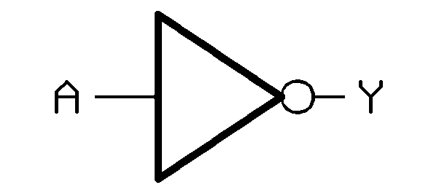
McCulloch-Pitts Neuron
Single-input McCulloch-Pitts neurode with b=0, w₁=-1 for binary inputs:
Conclusion?
b
x₁ | net | y
0 | 0 | 1
1 | -1 | 0
Σ
w₁
x₁
y

Slide 73
McCulloch-Pitts Neuron
Two-input McCulloch-Pitts neurode with b=-1, w₁=w₂=1 for binary inputs:
b
x₁
w₁
x₁ | x₂ | net | y
0 | 0 | ? | ?
0 | 1 | ? | ?
1 | 0 | ? | ?
1 | 1 | ? | ?
Σ
y
w₂
x₂

Slide 74
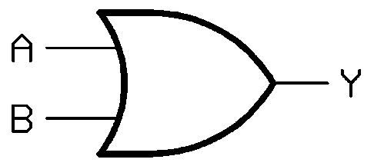
McCulloch-Pitts Neuron
Two-input McCulloch-Pitts neurode with b=-1, w₁=w₂=1 for binary inputs:
b
x₁
w₁
x₁ | x₂ | net | y
0 | 0 | -1 | 0
0 | 1 | 0 | 1
1 | 0 | 0 | 1
1 | 1 | 1 | 1
Σ
y
w₂
x₂

Slide 75
McCulloch-Pitts Neuron
Two-input McCulloch-Pitts neurode with b=-2, w₁=w₂=1 for binary inputs :
b
x₁
w₁
x₁ | x₂ | net | y
0 | 0 | ? | ?
0 | 1 | ? | ?
1 | 0 | ? | ?
1 | 1 | ? | ?
Σ
y
w₂
x₂

Slide 76
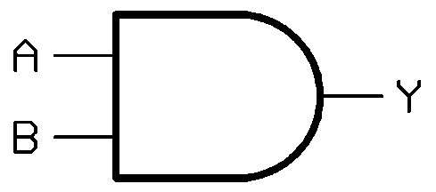
McCulloch-Pitts Neuron
Two-input McCulloch-Pitts neurode with b=-2, w₁=w₂=1 for binary inputs :
b
x₁
w₁
x₁ | x₂ | net | y
0 | 0 | -2 | 0
0 | 1 | -1 | 0
1 | 0 | -1 | 0
1 | 1 | 0 | 1
Σ
y
w₂
x₂

Slide 77
McCulloch-Pitts Neuron
Two-input McCulloch-Pitts neurode with b=-2, w₁=w₂=1 for binary inputs :
Y=F(net)=1 for net<0
=0 for net>=0
NAND Gate
b
x₁
w₁
x₁ | x₂ | net | y
0 | 0 | -2 | 1
0 | 1 | -1 | 1
1 | 0 | -1 | 1
1 | 1 | 0 | 0
Σ
y
w₂
x₂

Slide 78
McCulloch-Pitts Neuron
Two-input McCulloch-Pitts neurode with b=-0.5, w₁=w₂=1 for binary inputs :
Y=F(net)=1 for net<0
=0 for net>=0
NOR Gate
b
x₁
w₁
x₁ | x₂ | net | y
0 | 0 | -0.5 | 1
0 | 1 | 0.5 | 0
1 | 0 | 0.5 | 0
1 | 1 | 1.5 | 0
Σ
y
w₂
x₂

Slide 79
McCulloch-Pitts Neuron
Every basic Boolean function can be implemented using combinations of McCulloch-Pitts Neurons.

Slide 80
McCulloch-Pitts Neuron
the McCulloch-Pitts neuron can be used as a classifier that separate the input signals into two classes (perceptron):
X2
Class A (y=1)
Class A ⇔ y=?
y = 1 ⇔ net = ?
net ≥ 0 ⇔ ?
b+w₁x₁+w₂x₂ ≥ 0
Class B (y=0)
Class B ⇔ y=?
y = 0 ⇔ net = ?
net < 0 ⇔ ?
b+w₁x₁+w₂x₂ < 0
X1

Slide 81
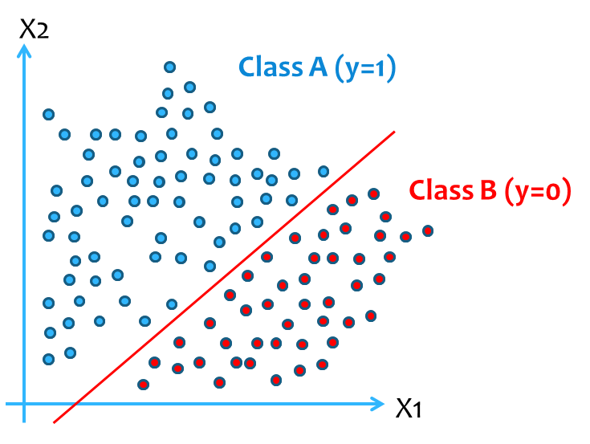
McCulloch-Pitts Neuron
Class A ⇔ b+w₁x₁+w₂x₂ ≥ 0
Class B ⇔ b+w₁x₁+w₂x₂ < 0
Therefore, the decision boundary is a hyperline given by
b+w₁x₁+w₂x₂ = 0
Where w₁ and w₂ come from?

Slide 82
McCulloch-Pitts Neuron
Solution: More Neurons Required
X2
X2
X2
?
X1
X1
X1
X1 and x2
X1 or x2
X1 xor x2

Slide 83
McCulloch-Pitts Neuron
Nonlinear Classification
X2
Class A (y=1)
Class B (y=0)
X1

Slide 84
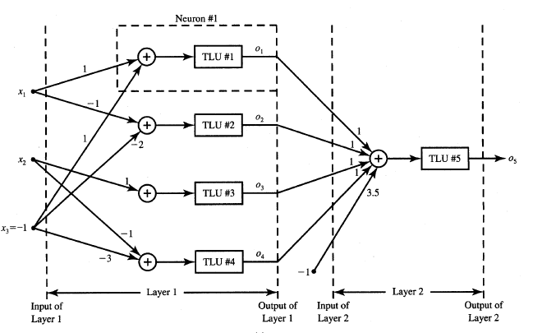
The analysis of a two-layer feedforward network using neurons having the bipolar binary activation function given Main purpose is to find output o₅ for a given network and input pattern. Each of the network layers is described

Slide 85
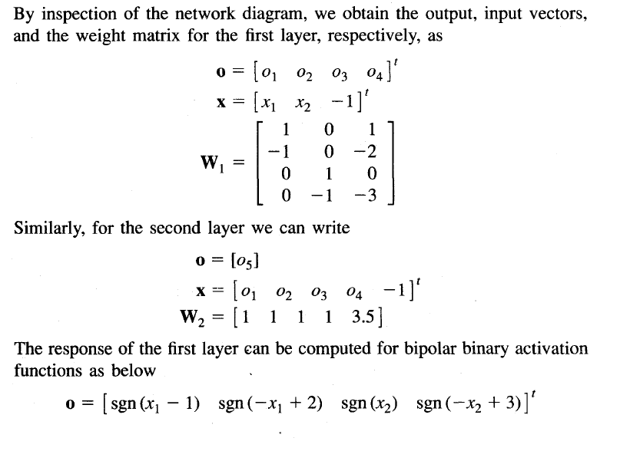

Slide 86

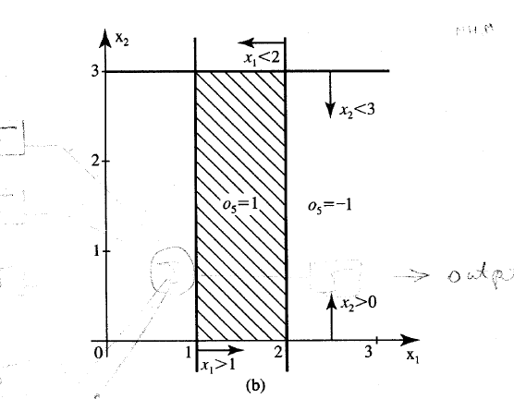

Slide 87
P) The Network used in the figure is an analog – to- digital converter and can be used for coding a continuous value x into 4 bit unipolar binary code (o₃ o₂ o₁ o₀). Analyze the network and find the range of x that is converted in each of the binary code(0 0 0 0),…..(1 1 1 1).Assume -1<x<16 and unipolar binary neurons.

Slide 88
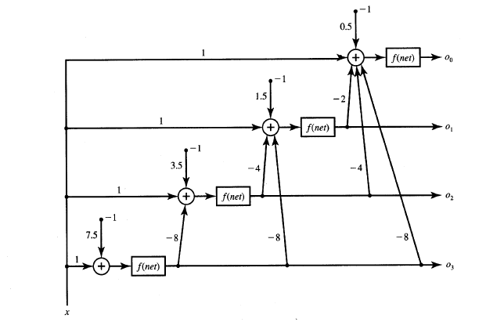

Slide 89
Construct a truth tables for two inputs by Mc-Cullouch Pitts neuron model with weights are shown in table
S.no | W1 | W2 | Threshold Value
1 | 0.5 | 0.2 | 0.2
2 | 0.8 | 0.5 | 0.8
3 | 0.6 | 0.4 | 0.5

Slide 90
ANN Learning rules.
McCulloch-Pitts neuron capable of: storing information and producing logical and arithmetical operations on it.
The next step must be to realise another important function of the brain, which is to acquire new knowledge through experience, i.e. learning.

Slide 91
ANN Learning rules.
Learning means
to change in response to experience.
In a network of MP-neurons binary weights of connections and thresholds are fixed. The only change can be the change of pattern of connections, which is technically expensive.
Some easily changeable free parameters are needed.

Slide 92
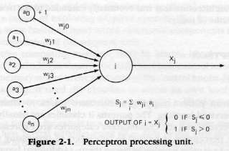
ANN Learning rules.
Abstract neuron.
The ideal free parameters to adjust, and so to resolve learning without changing pattern of connections, are the weights of connections w_{ji}.

Slide 93
ANN Learning rules.
Definition:
ANN learning rule defines how to adjust the weights of connections to get desirable output.

Slide 94
Hebb’s rule (1949).
The simplest formalisation of Hebb’s rule is to increase weight of connection at every next instant in the way:
(1)
where
(2)

Slide 95
Hebb’s rule (1949).
(1)
where
(2)
here
w_{ji}^{k} is the weight of connection at instant k,
w_{ji}^{k+1} is the weight of connection at the following instant k+1,
Δw_{ji}^{k} is increment by which the weight of connection is enlarged,
C is positive coefficient which determines learning rate,
a_{i}^{k} is input value from the pre synaptic neuron at instant k,
X_{j}^{k} is output of the postsynaptic neuron at the same instant k.

Slide 96
Hebb’s rule (1949).
(1)
where
(2)
Thus, the weight of connection changes at the next instant only if both preceding input via this connection and the resulting output simultaneously are not equal to 0.

Slide 97
Hebb’s rule (1949).
(1)
where
(2)
Equation (2) emphasises the correlation nature of a Hebbian synapse. It is sometimes referred to as the activity product rule.

Slide 98
Hebb’s rule (1949).
(1)
where
(2)
For this reason, Hebb’s rule plays an important role in studies of ANN algorithms much “younger” than the rule itself, such as unsupervised learning or self-organisation, which we shall consider later.

Slide 99
Hebb’s Law can be represented in the form of two rules:
If two neurons on either side of a connection are activated synchronously, then the weight of that connection is increased.
If two neurons on either side of a connection are activated asynchronously, then the weight of that connection is decreased.
Hebb’s Law provides the basis for learning without a teacher. Learning here is a local phenomenon occurring without feedback from the environment.

Slide 100
Hebb’s rule in practice.
Input unit
Nº
1
2
3
4
a
1
w
1
a
w
2
2
θ
X
a
w
3
3
w
4
a
4

Slide 101
Hebb’s rule in practice.
Input unit
Nº
1
2
3
4
t=0 C=1
1
w⁰₁ | w⁰₂ | w⁰₃ | w⁰₄
1 | 1 | 1 | 1
1
θ =2
X
1
1

Slide 102
Hebb’s rule in practice.
Input unit
Nº
1
2
3
4
t=0 C=1
1
1
a⁰₁ | a⁰₂ | a⁰₃ | a⁰₄
1 | 0 | 1 | 0
w⁰₁ | w⁰₂ | w⁰₃ | w⁰₄
1 | 1 | 1 | 1
1
0
θ =2
X
1
1
1
0

Slide 103
Hebb’s rule in practice.
Input unit
Nº
1
2
3
4
t=0 C=1
a⁰₁ | a⁰₂ | a⁰₃ | a⁰₄
1 | 0 | 1 | 0
w⁰₁ | w⁰₂ | w⁰₃ | w⁰₄
1 | 1 | 1 | 1
1
1
1
0
θ =2
X
1
1
1
0

Slide 104
Hebb’s rule in practice.
Input unit
Nº
1
2
3
4
t=0 C=1
a⁰₁ | a⁰₂ | a⁰₃ | a⁰₄
1 | 0 | 1 | 0
w⁰₁ | w⁰₂ | w⁰₃ | w⁰₄
1 | 1 | 1 | 1
1
1
1
0
θ =2
X
1
1
1
0

Slide 105
Hebb’s rule in practice.
Input unit
Nº
1
2
3
4
t=0 C=1
a⁰₁ | a⁰₂ | a⁰₃ | a⁰₄
1 | 0 | 1 | 0
w⁰₁ | w⁰₂ | w⁰₃ | w⁰₄
1 | 1 | 1 | 1
1
1
1
0
θ =2
1
1
1
1
0

Slide 106
Hebb’s rule in practice.
Input unit
Nº
1
2
3
4
t=0 C=1
a⁰₁ | a⁰₂ | a⁰₃ | a⁰₄
1 | 0 | 1 | 0
w⁰₁ | w⁰₂ | w⁰₃ | w⁰₄
1 | 1 | 1 | 1
1
1
0
1
θ =2
1
1
1
1
0

Slide 107
Hebb’s rule in practice.
a⁰₁ | a⁰₂ | a⁰₃ | a⁰₄
1 | 0 | 1 | 0
Input unit
Nº
1
2
3
4
t=1 C=1
w¹₁ | w¹₂ | w¹₃ | w¹₄
2 | 1 | 2 | 1
2
1
θ =2
X
2
1

Slide 108
Hebb’s rule in practice.
Input unit
Nº
1
2
3
4
t=1 C=1
w¹₁ | w¹₂ | w¹₃ | w¹₄
2 | 1 | 2 | 1
2
1
θ =2
X
2
1

Slide 109
Hebb’s rule in practice.
Input unit
Nº
1
2
3
4
t=1 C=1
a¹₁ | a¹₂ | a¹₃ | a¹₄
1 | 0 | 1 | 0
w¹₁ | w¹₂ | w¹₃ | w¹₄
2 | 1 | 2 | 1
1
2
0
1
θ =2
X
1
2
1
0

Slide 110
Hebb’s rule in practice.
Input unit
Nº
1
2
3
4
t=1 C=1
a¹₁ | a¹₂ | a¹₃ | a¹₄
1 | 0 | 1 | 0
w¹₁ | w¹₂ | w¹₃ | w¹₄
2 | 1 | 2 | 1
1
2
0
1
θ =2
X
1
2
1
0

Slide 111
Hebb’s rule in practice.
Input unit
Nº
1
2
3
4
t=1 C=1
a¹₁ | a¹₂ | a¹₃ | a¹₄
1 | 0 | 1 | 0
w¹₁ | w¹₂ | w¹₃ | w¹₄
2 | 1 | 2 | 1
1
2
0
1
θ =2
1
1
2
1
0

Slide 112
Hebb’s rule in practice.
Input unit
Nº
1
2
3
4
t=1 C=1
a¹₁ | a¹₂ | a¹₃ | a¹₄
1 | 0 | 1 | 0
w¹₁ | w¹₂ | w¹₃ | w¹₄
2 | 1 | 2 | 1
1
2
0
1
θ =2
1
1
2
1
0

Slide 113
Hebb’s rule in practice.
a¹₁ | a¹₂ | a¹₃ | a¹₄
1 | 0 | 1 | 0
Input unit
Nº
1
2
3
4
t=2 C=1
w²₁ | w²₂ | w²₃ | w²₄
3 | 1 | 3 | 1
3
1
θ =2
X
3
1

Slide 114
Hebb’s rule in practice.
Input unit
Nº
1
2
3
4
t=2 C=1
w²₁ | w²₂ | w²₃ | w²₄
3 | 1 | 3 | 1
3
1
θ =2
X
3
1

Slide 115
Hebb’s rule in practice.
Input unit
Nº
1
2
3
4
t=2 C=1
a²₁ | a²₂ | a²₃ | a²₄
w²₁ | w²₂ | w²₃ | w²₄
3 | 1 | 3 | 1
3
1
θ =2
X
3
1

Slide 116
Hebb’s rule in practice.
Input unit
Nº
1
2
3
4
t=2 C=1
a²₁ | a²₂ | a²₃ | a²₄
1 | 0 | 1 | 0
w²₁ | w²₂ | w²₃ | w²₄
3 | 1 | 3 | 1
1
3
0
1
θ =2
X
1
3
1
0

Slide 117
Hebb’s rule in practice.
Input unit
Nº
1
2
3
4
t=2 C=1
a²₁ | a²₂ | a²₃ | a²₄
1 | 1 | 0 | 0
w²₁ | w²₂ | w²₃ | w²₄
3 | 1 | 3 | 1
1
3
1
1
θ =2
X
0
3
1
0

Slide 118
Hebb’s rule in practice.
Input unit
Nº
1
2
3
4
t=2 C=1
a²₁ | a²₂ | a²₃ | a²₄
1 | 1 | 0 | 0
w²₁ | w²₂ | w²₃ | w²₄
3 | 1 | 3 | 1
1
3
1
1
θ =2
1
0
3
1
0

Slide 119
Hebb’s rule in practice.
Input unit
Nº
1
2
3
4
t=2 C=1
a²₁ | a²₂ | a²₃ | a²₄
1 | 1 | 0 | 0
w²₁ | w²₂ | w²₃ | w²₄
3 | 1 | 3 | 1
1
3
1
1
θ =2
1
0
3
1
0

Slide 120
Hebb’s rule in practice.
a²₁ | a²₂ | a²₃ | a²₄
1 | 1 | 0 | 0
Input unit
Nº
1
2
3
4
t=3 C=1
w³₁ | w³₂ | w³₃ | w³₄
4 | 2 | 3 | 1
4
2
θ =2
X
3
1

Slide 121
Hebb’s rule in practice.
Input unit
Nº
1
2
3
4
t=3 C=1
w³₁ | w³₂ | w³₃ | w³₄
4 | 2 | 3 | 1
4
2
θ =2
X
3
1
And so on…

Slide 122
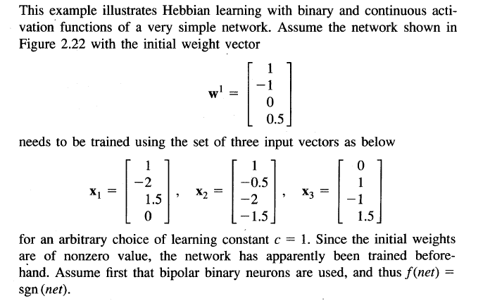

Slide 123
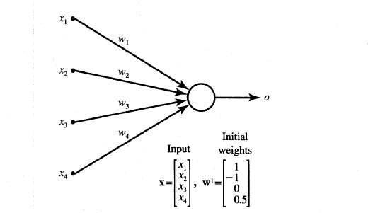

Slide 124
Perceptron Learning rule
Learning signal is the difference between the desired and actual neuron’s response
Learning is supervised

Slide 125
Delta Learning Rule
Only valid for continuous activation function
Used in supervised training mode
Learning signal for this rule is called delta
The aim of the delta rule is to minimize the error over all training patterns

Slide 126




Delta Learning Rule Contd.
Learning rule is derived from the condition of least squared error.
Calculating the gradient vector with respect to wi
Minimization of error requires the weight changes to be in the negative gradient direction

Slide 127
Widrow-Hoff learning Rule
Also called as least mean square learning rule
Introduced by Widrow(1962), used in supervised learning
Independent of the activation function
Special case of delta learning rule wherein activation function is an identity function ie f(net)=net
Minimizes the squared error between the desired output value d_{i} and net_{i}

Slide 128
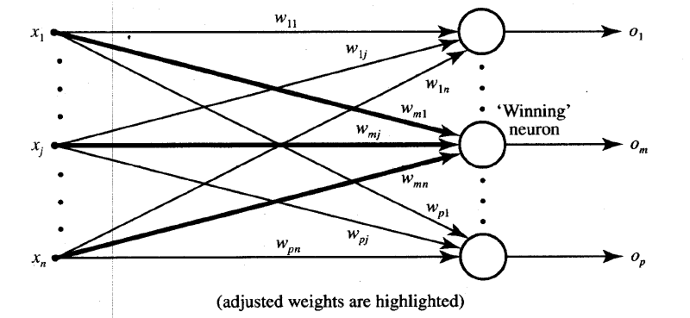
Winner-Take-All learning rules

Slide 129
Winner-Take-All Learning rule Contd…
Can be explained for a layer of neurons
Example of competitive learning and used for unsupervised network training
Learning is based on the premise that one of the neurons in the layer has a maximum response due to the input x
This neuron is declared the winner with a weight

Slide 130
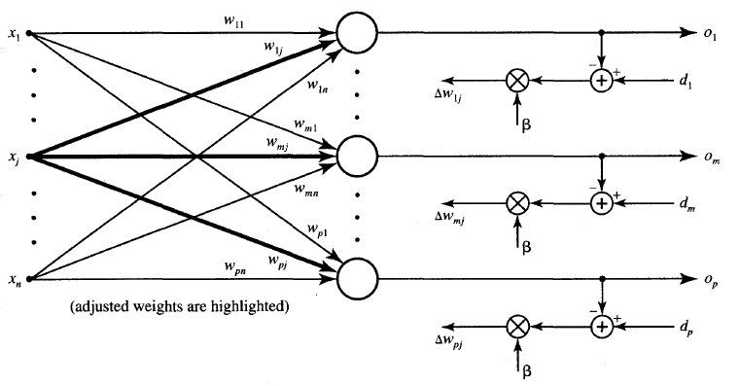
Outstar learning rule

Slide 131
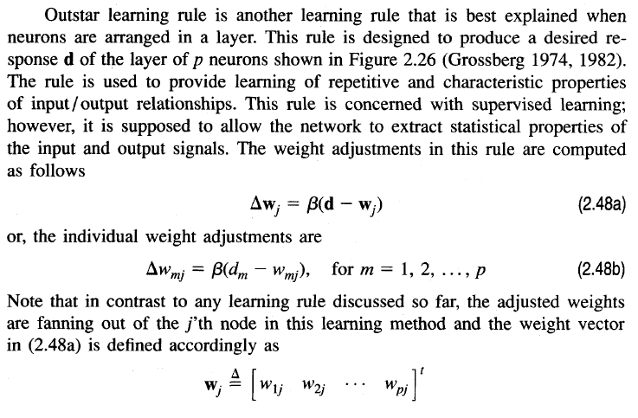
Outstar learning rule

Slide 132
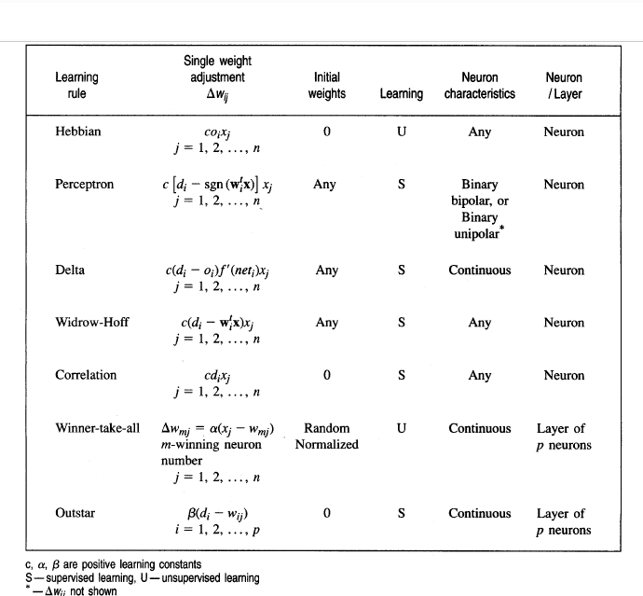
Summary of learning rules

Slide 133
Perceptrons
Rosenblatt (1958) explicitly considered the problem of pattern recognition, where a “teacher” is essential.
- First studied in the late 1950s.
- Also known as Layered Feed-Forward Networks.
- The only efficient learning element at that time was for single-layered networks.
- Today, used as a synonym for a single-layer, feed-forward network.

Slide 134
Multi-layer Networks and Perceptrons
- Networks without hidden layer are called perceptrons.
- Perceptrons are very limited in what they can represent, but this makes their learning problem much simpler.
- Have one or more layers of hidden units.
- With two possibly very large hidden layers, it is possible to implement any function.

Slide 135
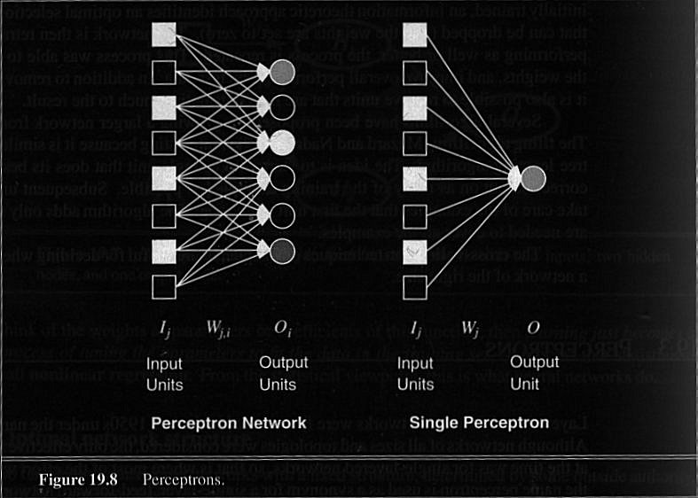

Slide 136
Perceptron application
+
+
+
+
+
+
+
+
+
+
+
+
+
+
+
+
+
+
+
+
+
+
+
+
+
+
+
+
+
+
+
+
+
+
+
+

Slide 137
Architecture
We consider the architecture: feed-forward NN with one layer
It is sufficient to study single layer perceptrons with just one neuron:

Slide 138
Perceptron: Neuron Model
Uses a non-linear (McCulloch-Pitts) model of neuron:
b (bias)
x₁
w₁
v
y
x₂
w₂
ϕ(v)
w_{m}
x_{m}
ϕ is the sign function:
+1 IF v >= 0
ϕ(v) =
Is the function sign(v)
-1 IF v < 0

Slide 139
Perceptron learning rule
Teacher specifies the desired output for a given input
Network calculates what it thinks the output should be
Network changes its weights in proportion to the error between the desired & calculated results
Δw_{i,j} = α * [teacher_{i} - output_{i}] * input_{j}
where:
α is the learning rate;
teacher_{i} - output_{i} is the error term;
and input_{j} is the input activation
w_{i,j =} w_{i,j} + Δw_{i,j}
Delta rule

Slide 140
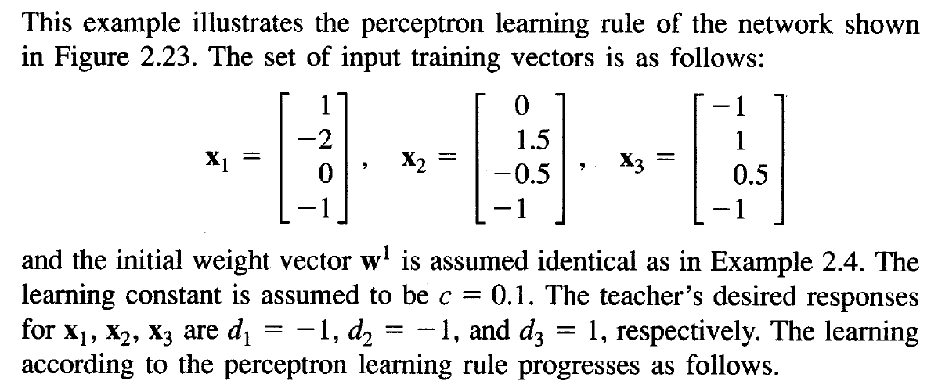

Slide 141
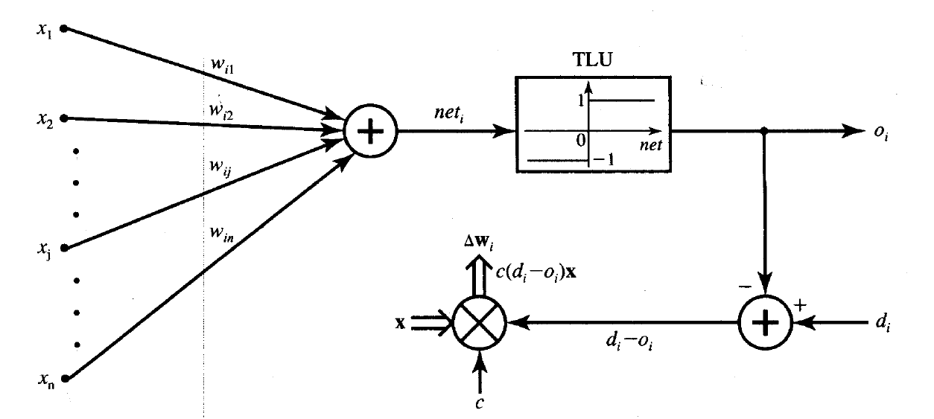

Slide 142
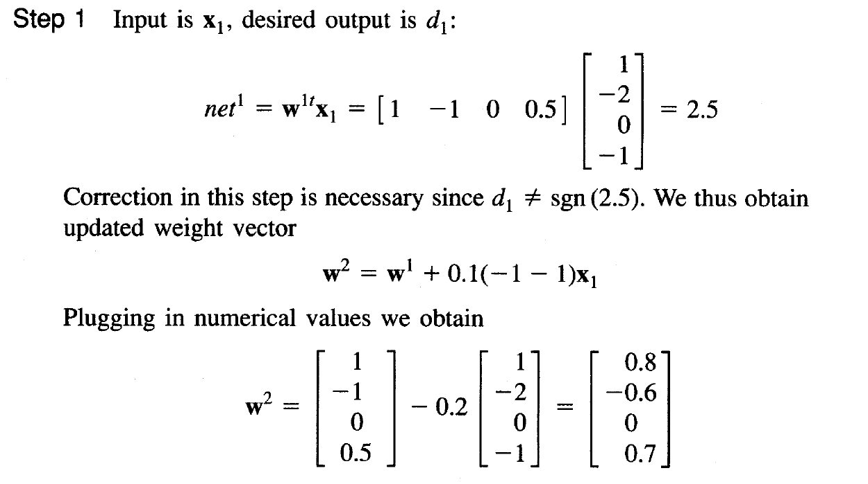

Slide 143
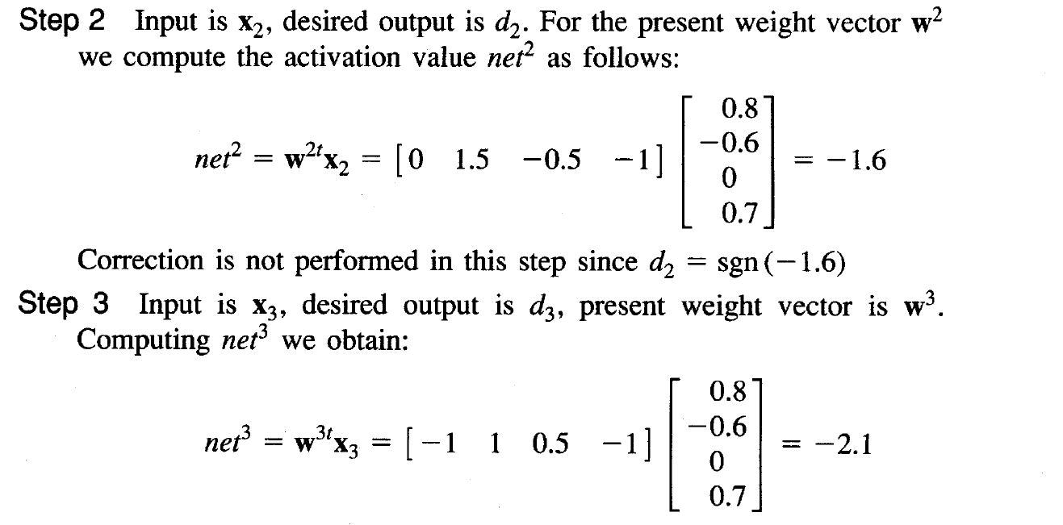

Slide 144


Slide 145
Perceptron: Applications
The perceptron is used for classification: classify correctly a set of examples into one of the two classes C₁, C₂:
If the output of the perceptron is +1 then the input is assigned to class C₁
If the output is -1 then the input is assigned to C₂

Slide 146
Perceptron: Classification
The equation below describes a hyperplane in the input space. This hyperplane is used to separate the two classes C1 and C2
decision
region for C1
x₂
w₁x₁ + w₂x₂ + b > 0
decision
boundary
C₁
decision
region for C₂
x₁
C₂
w₁x₁ + w₂x₂ + b <= 0
w₁x₁ + w₂x₂ + b = 0

Slide 147
Perceptron: Limitations
The perceptron can only model linearly separable functions.
The perceptron can be used to model the following Boolean functions:
AND
OR
COMPLEMENT
But it cannot model the XOR. Why?

Slide 148
Perceptron: Limitations
The XOR is not linear separable
It is impossible to separate the classes C₁ and C₂ with only one line
C₁
x₂
C₂
1
1
-1
C₁
0
-1
1
0
1
x₁

Slide 149
Perceptron: Learning Algorithm
Variables and parameters
x(n) = input vector
= [+1, x₁(n), x₂(n), …, x_{m}(n)]^{T}
w(n) = weight vector
= [b(n), w₁(n), w₂(n), …, w_{m}(n)]^{T}
b(n) = bias
y(n) = actual response
d(n) = desired response
η = learning rate parameter

Slide 150
The fixed-increment learning algorithm
Initialization: set w(0) =0
Activation: activate perceptron by applying input example (vector x(n) and desired response d(n))
Compute actual response of perceptron:
y(n) = sgn[w^{T}(n)x(n)]
Adapt weight vector: if d(n) and y(n) are different then
w(n + 1) = w(n) + η[d(n)-y(n)]x(n)
+1 if x(n) ∈ C₁
Where d(n) =
-1 if x(n) ∈ C₂
Continuation: increment time step n by 1 and go to Activation step

Slide 151
Adaptive Linear Neuron (Adaline)
Adaline which stands for Adaptive Linear Neuron, is a network having a single linear unit. It was developed by Widrow and Hoff in 1960. Some important points about Adaline are as follows −
It uses bipolar activation function.
It uses delta rule for training to minimize the Least Mean-Squared Error LMSE between the actual output and the desired/target output.
The weights and the bias are adjustable.

Slide 152


Slide 153
Training Algorithm
Step 1 − Initialize the following to start the training −
Weights
Bias
Learning rate α
For easy calculation and simplicity, weights and bias must be set equal to 0 and the learning rate must be set equal to 1.
Step 2 − Continue step 3-8 when the stopping condition is not true.
Step 3 − Continue step 4-6 for every bipolar training pair s:t.
Step 4 − Activate each input unit as follows −
x_{i}=s_{i} (i=1 to n)

Slide 154
Training Algorithm(Cont)
Step 5 − Obtain the net input with the following relation −
y_{in}=b+∑x_{i}w_{i}(i=1 to n)
Here ‘b’ is bias and ‘n’ is the total number of input neurons.
Step 6 − Apply the following activation function to obtain the final output −
Step 7 − Adjust the weight and bias as follows −
Case 1 − if y ≠ t then,
w_{i(new)} =w_{i(old)+}α(t−y_{in})xi
b(new)=b(old)+α(t−yin)
Case 2 − if y = t then,
w_{i(new)}= w _{i(old)}
b(new)=b (old)
Here ‘y’ is the actual output and ‘t’ is the desired/target output.
Step 8 − Test for the stopping condition, which will happen when there is no change in weight or the highest weight change occurred during training is smaller than the specified tolerance.

Slide 155
Adaline: Adaptive Linear Element
Adaline: uses a linear neuron model and the Least-Mean-Square (LMS) learning algorithm
The idea: try to minimize the square error, which is a function of the weights
We can find the minimum of the error function E by means of the Steepest descent method

Slide 156
Steepest Descent Method
start with an arbitrary point
find a direction in which E is decreasing most rapidly
make a small step in that direction

Slide 157
Least-Mean-Square algorithm (Widrow-Hoff algorithm)
Approximation of gradient(E)
Update rule for the weights becomes:

Slide 158
Multiple Adaptive Linear Neuron M-adaline
Madeline which stands for Multiple Adaptive Linear Neuron, is a network which consists of many Adalines in parallel. It will have a single output unit.
Some important points about Madaline are as follows
It is just like a multilayer perceptron, where Adaline will act as a hidden unit between the input and the Madaline layer.
The weights and the bias between the input and Adaline layers, as in we see in the Adaline architecture, are adjustable.
The Adaline and Madaline layers have fixed weights and bias of 1.
Training can be done with the help of Delta rule.

Slide 159
The architecture of Madaline consists of “n” neurons of the input layer, “m” neurons of the Adaline layer, and 1 neuron of the Madaline layer. The Adaline layer can be considered as the hidden layer as it is between the input layer and the output layer, i.e. the Madaline layer.

Slide 160

Architecture

Slide 161
Training Algorithm
By now we know that only the weights and bias between the input and the Adaline layer are to be adjusted, and the weights and bias between the Adaline and the Madaline layer are fixed.
Step 1 − Initialize the following to start the training −
Weights
Bias
Learning rate α
Step 2 − Continue step 3-8 when the stopping condition is not true.
Step 3 − Continue step 4-6 for every bipolar training pair s:t.
Step 4 − Activate each input unit as follows −
x_{i}=s_{i}(I =1 to n)

Slide 162
Training Algorithm
Step 5 − Obtain the net input at each hidden layer, i.e. the Adaline layer with the following relation −
Q_{inj}=b_{j}+∑x_{i}w_{ij} j=1tom
Here ‘b’ is bias and ‘n’ is the total number of input neurons.
Step 6 − Apply the following activation function to obtain the final output at the Adaline and the Madaline layer −
f(x)={1 ifx⩾0
={0 if x<0
Output at the hidden Adaline unit
Qj=f(Qinj)
Final output of the network
y=f(y_{in})
i.e. y_{inj}=b₀+∑Q_{j}v_{j}

Slide 163
Training Algorithm
Step 7 − Calculate the error and adjust the weights as follows −
Case 1 −
if y ≠ t and t = 1 then,
W _{ij(new)}=w _{ij(old)}+α(1−Q _{inj})
B _{j(new)}=b _{j(old)}+α(1−Q _{inj})
In this case, the weights would be updated on Q_{j} where the net input is close to 0 because t = 1.
Case 2 − if y ≠ t and t = -1 then,
wik(new)=wik(old)+α(−1−Qink)
bk(new)=bk(old)+α(−1−Qink)
In this case, the weights would be updated on Q_{k} where the net input is positive because t = -1.
Here ‘y’ is the actual output and ‘t’ is the desired/target output.
Case 3 − if y = t then
There would be no change in weights.

Slide 164
Training Algorithm
Step 8 − Test for the stopping condition, which will happen when there is no change in weight or the highest weight change occurred during training is smaller than the specified tolerance.

Slide 165

XOR Using Activation Function as Binary Unipolar
x₁ | x₂ | Y
0 | 0 | 0
0 | 1 | 1
1 | 0 | 1
1 | 1 | 0

Slide 166


